Slide 1
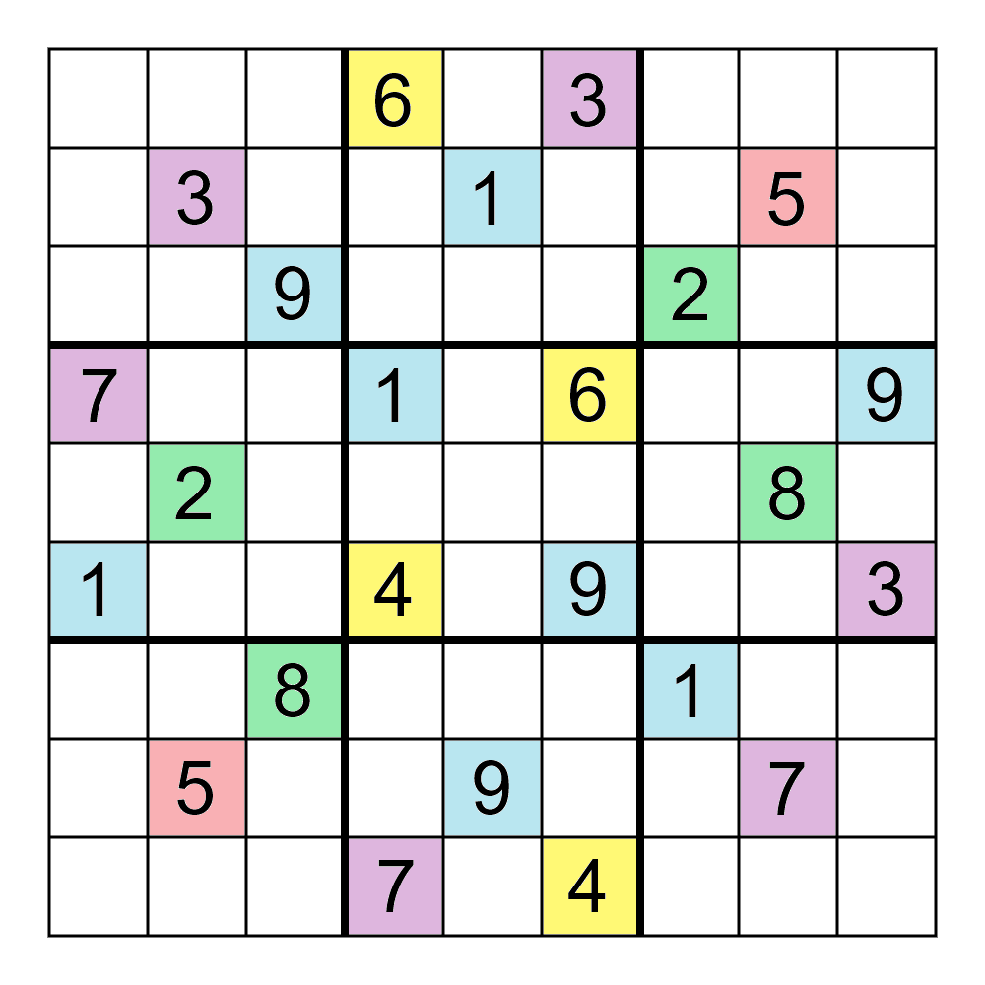
Soduko game
Based on C language
(NTI TEAM)

Slide 2
Team Members:
. Magdy Khalifa (Team Leader ) . Fatma Mosaad
. Elaf Mohamed . Ahmed Gamal
. Ola Mohamed

Slide 3
Agenda
Overview
Features
Flowchart
Sprints Vs Burn up graph
Video

Slide 4
Over View
overview of how Sudoku is played:
1. Initial Setup
2. Number Placement
3. Logic and Deduction
4. Trial and Error
5. Completion

Slide 5
Features
Sudoku Live Game
Multiple Levels
User-Friendly Interface : like Loading Bar Graphics – Music
Error Detection
Help Feature
Real-Time Updates

Slide 6
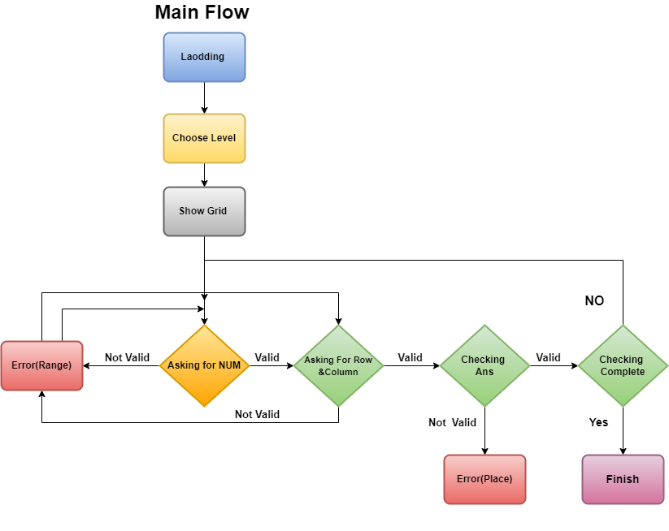
Flowchart

Slide 7
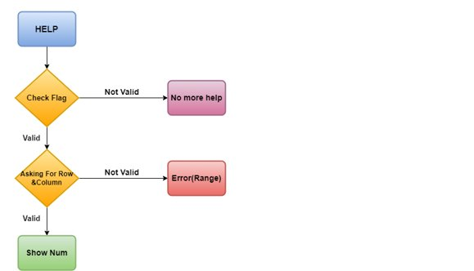

Slide 8
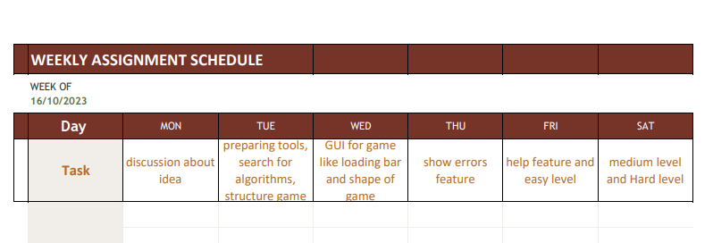
Sprints

Slide 9
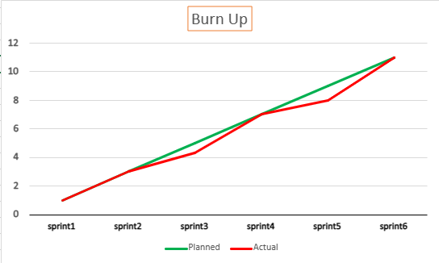
Burn up graph​

Slide 10
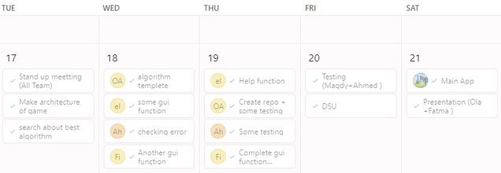

Slide 11
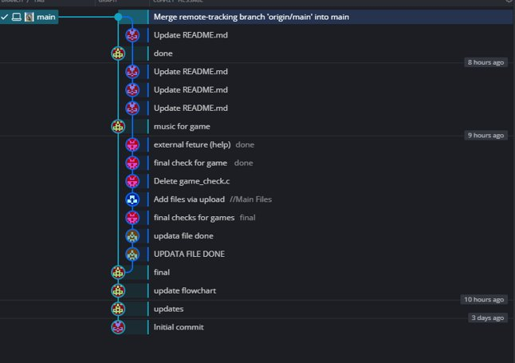

Slide 12
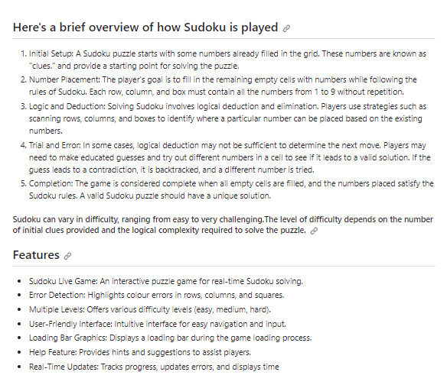

Slide 13
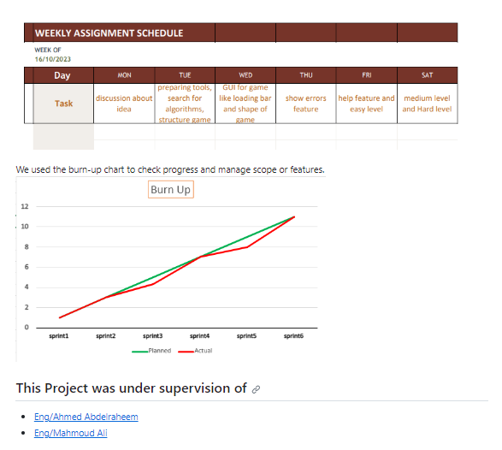
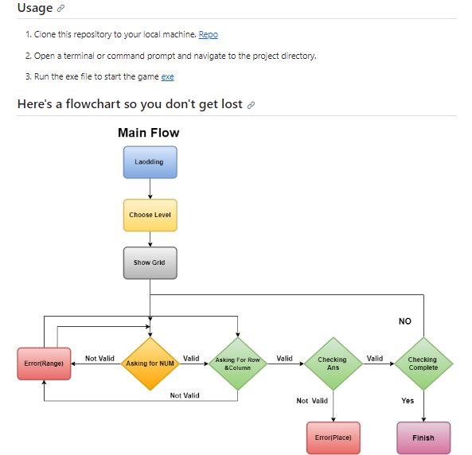

Slide 14
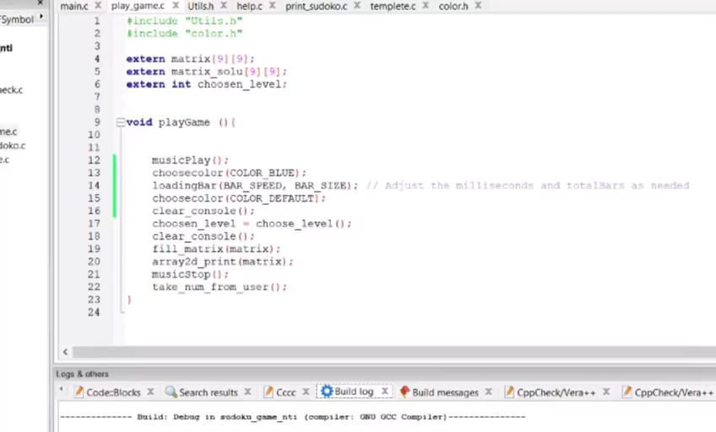
Video

Slide 15
Thanks.

